Slide 1
GIN stats statistics for experimental molecular biology
George Wiggins
John Pearson

Slide 2
Format
3 paired lectures
Theory
Practical
Topics:
Small experiments
Diagnostic Tests
?

Slide 3
COVID-19 testing in NZ
Health.gov.nz
COVID-19 (novel coronavirus)

Slide 4
COVID-19 testing in NZ
 |  | Disease
 |  | + |  | - |  | Totals |  | Population |  | N | 300000
Test | + | 2850 |  | 11880 |  | 14730 | 4.91% | Positive Predictive Value |  | TP/ (TP+FP) | 19.348% | How good a positive test is at ruling in a disease
 | - | 150 |  | 285120 |  | 285270 | 95.09% | Negative Predictive Value |  | TN/ (TN+FN) | 99.947% | How good a negtive test is at ruling out a disease
 | Totals | 3000 |  | 297000 |  | 300000 |  | Prevalence Proportion |  | p | 1.000% | Proportion of people with the disease
 |  | 1.00% |  | 99.00%
 |  | Sensitivity | 95.00% | Specificity | 96.00%
 |  | TP/(TP+FN) |  | TN/(FP+TN)
 |  | How good the test is at correctly identifying those with the disease |  | How good the test is at correctly identifying those without the disease

Slide 5
COVID-19 testing in NZ
 |  | Disease
 |  | + |  | - |  | Totals |  | Population |  | N | 300000
Test | + | 285 |  | 11988 |  | 12273 | 4.09% | Positive Predictive Value |  | TP/ (TP+FP) | 2.322% | How good a positive test is at ruling in a disease
 | - | 15 |  | 287712 |  | 287727 | 95.91% | Negative Predictive Value |  | TN/ (TN+FN) | 99.995% | How good a negtive test is at ruling out a disease
 | Totals | 300 |  | 299700 |  | 300000 |  | Prevalence Proportion |  | p | 0.100% | Proportion of people with the disease
 |  | 0.10% |  | 99.90%
 |  | Sensitivity | 95.00% | Specificity | 96.00% |  |  | Q: | If I test positive how much greater is my risk of having COVID?
 |  | TP/(TP+FN) |  | TN/(FP+TN)
 |  |  |  |  |  |  |  | Odds Ratio | = | Odds of testing positive with the Disease
 |  | How good the test is at correctly identifying those with the disease |  | How good the test is at correctly identifying those without the disease |  |  |  |  |  | Odds of testing positive without the Disease
 |  |  |  |  |  |  |  |  | = | TP/FN
 |  |  |  |  |  |  |  |  |  | FP/TN
 |  |  |  |  |  |  |  |  | = | 19.000
 |  |  |  |  |  |  |  |  |  | 4.167E-02
 |  |  |  |  |  |  |  |  | = | 456.00
 |  |  |  |  |  |  |  | Q: | Why use OR instead of RR?
 |  |  |  |  |  |  |  | A: | estimated by sampling
 |  |  |  |  |  |  |  |  | logistic regression
 |  |  |  |  |  |  |  |  | OR approximates RR for rare disease
 |  |  |  |  |  |  |  |  | Doesn't depend on prevalence
 |  |  |  |  |  |  |  |  | logOR is approximately Normal

Slide 6
Assessing a Diagnostic Test
Measure levels of an analyte in a test, say qPCR for a corona virus spike protein, and predict likelihood of diagnosis, death, diseas status.

Slide 7
BNP as a biomarker of Heart Failure
Example: Levels of NT pro BNP as a predictor of Heart Failure.
416 patients with 167 Heart Failure Dx
ROCdat.csv
…
416 rows
PID | Age | HF | Assay
85 | 77 | 0 | 110.8
87 | 67 | 0 | 198.3
90 | 84 | 1 | 310
91 | 80 | 0 | 77.37

Slide 8
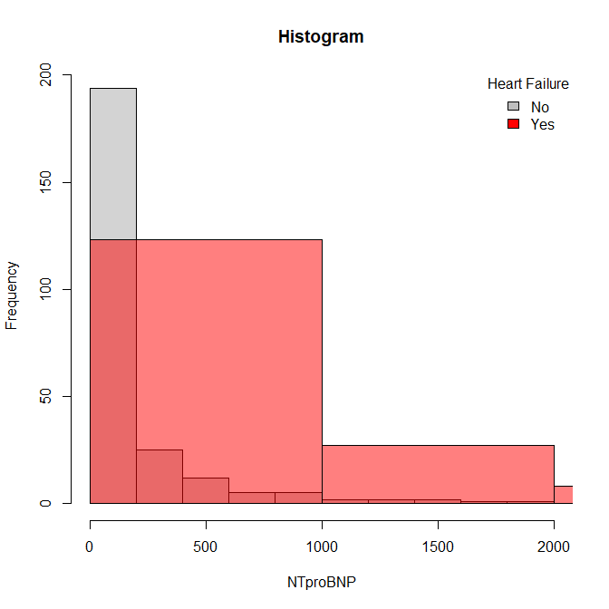
BNP as a biomarker of Heart Failure
Example: Levels of NT pro BNP as a predictor of Heart Failure.
PID | Age | HF | Assay
85 | 77 | 0 | 110.8
87 | 67 | 0 | 198.3
90 | 84 | 1 | 310
91 | 80 | 0 | 77.37

Slide 9
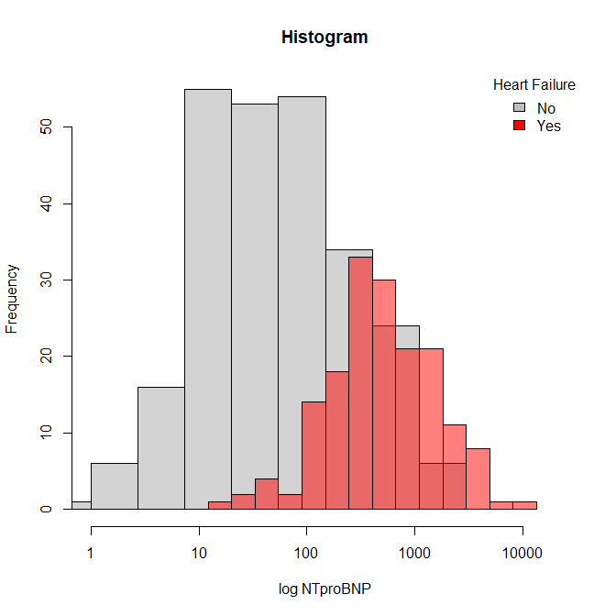
BNP as a biomarker of Heart Failure
Example: Levels of NT pro BNP as a predictor of Heart Failure.
NTpBNP
mean 460.9
Median 149.3
t-test P 9.5x10⁻¹²
Mean HF 897
Mean no HF 169
PID | Age | HF | Assay
85 | 77 | 0 | 110.8
87 | 67 | 0 | 198.3
90 | 84 | 1 | 310
91 | 80 | 0 | 77.37

Slide 10
BNP as a biomarker of Heart Failure
Example: Levels of NT pro BNP as a predictor of Heart Failure.
Q: Does NTpBNP predict HF?
A: t-test NTpBNP in HF vs no HF
t-test P 9.5x10⁻¹²
Mean HF 897
Mean no HF 169

Slide 11
BNP as a biomarker of Heart Failure
Example: Levels of NT pro BNP as a predictor of Heart Failure.
Q: What is the cutoff value for a
Diagnostic test?
(or what values are normal?)
A:
NTpBNP
mean 460.9
Median 149.3
Lets try 150.

Slide 12
BNP as a biomarker of Heart Failure
Example: Levels of NT pro BNP as a predictor of Heart Failure.
NTpBNP > 150 |  | Disease
 |  | + |  | - |  | Totals |  | Population |  | N | 416
Test | + | 144 |  | 64 |  | 208 | 50.00% | Positive Predictive Value |  | TP/(TP+FP) | 69.231% | How good a positive test is at ruling in a disease
 | - | 23 |  | 185 |  | 208 | 50.00% | Negative Predictive Value |  | TN/ (TN+FN) | 88.942% | How good a negtive test is at ruling out a disease
 | Totals | 167 |  | 249 |  | 416 |  | Prevalence Proportion |  | p | 40.144% | Proportion of people with the disease
 |  | 40.14% |  | 59.86%
 |  | Sensitivity | 86.23% | Specificity | 74.30% |  |  | Odds Ratio | = | Odds of testing positive with the Disease
 |  | TP/(TP+FN) |  | TN/(FP+TN) |  |  |  |  |  | Odds of testing positive without the Disease
 |  |  |  |  |  |  |  |  | = | TP/FN |  | =
 |  | How good the test is at correctly identifying those with the disease |  | How good the test is at correctly identifying those without the disease |  |  |  |  |  | FP/TN
 |  |  |  |  |  |  |  |  | = | 6.261
 |  |  |  |  |  |  |  |  |  | 3.459E-01
 |  |  |  |  |  |  |  |  | = | 18.10

Slide 13
BNP as a biomarker of Heart Failure
Example: Levels of NT pro BNP as a predictor of Heart Failure.
Repeat for all cutoffs, pick the “best one”.
NTpBNP > 150 |  | Disease
 |  | + |  | - |  | Totals |  | Population |  | N | 416
Test | + | 144 |  | 64 |  | 208 | 50.00% | Positive Predictive Value |  | TP/(TP+FP) | 69.231% | How good a positive test is at ruling in a disease
 | - | 23 |  | 185 |  | 208 | 50.00% | Negative Predictive Value |  | TN/(TN+FN) | 88.942% | How good a negtive test is at ruling out a disease
 | Totals | 167 |  | 249 |  | 416 |  | Prevalence Proportion |  | p | 40.144% | Proportion of people with the disease
 |  | 40.14% |  | 59.86%
 |  | Sensitivity | 86.23% | Specificity | 74.30% |  |  | Odds Ratio | = | Odds of testing positive with the Disease
 |  | TP/(TP+FN) |  | TN/(FP+TN) |  |  |  |  |  | Odds of testing positive without the Disease
 |  |  |  |  |  |  |  |  | = | TP/FN |  | =
 |  | How good the test is at correctly identifying those with the disease |  | How good the test is at correctly identifying those without the disease |  |  |  |  |  | FP/TN
 |  |  |  |  |  |  |  |  | = | 6.261
 |  |  |  |  |  |  |  |  |  | 3.459E-01
 |  |  |  |  |  |  |  |  | = | 18.10

Slide 14
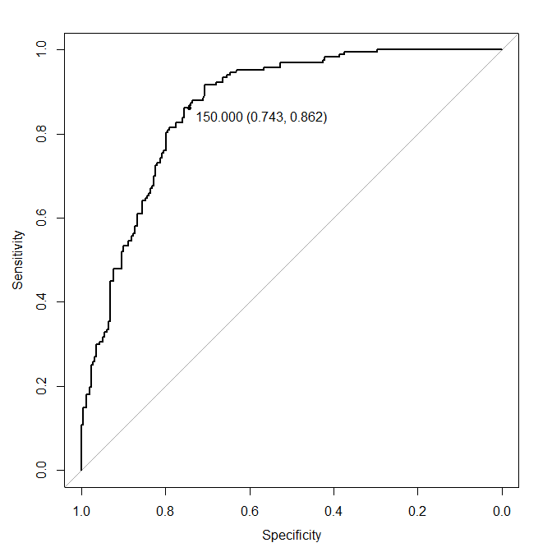
BNP as a biomarker of Heart Failure
ROC curve

Slide 15
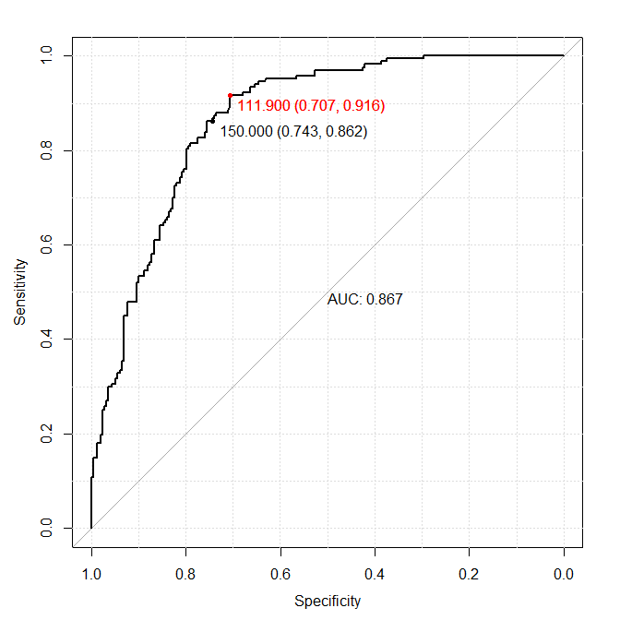
BNP as a biomarker of Heart Failure
ROC curve: could we do better?
Youden Max(Sensitivity+Specificity)
Area under the curve
Be careful summarizing
data like this with 1 number.

Slide 16
BNP as a biomarker of Heart Failure
clevelandclinic.org/ntpbnp
A normal level of NT-proBNP,
Less than 125 pg/mL for patients aged 0-74 years
Less than 450 pg/mL for patients aged 75-99 years
could we do better?

Slide 17
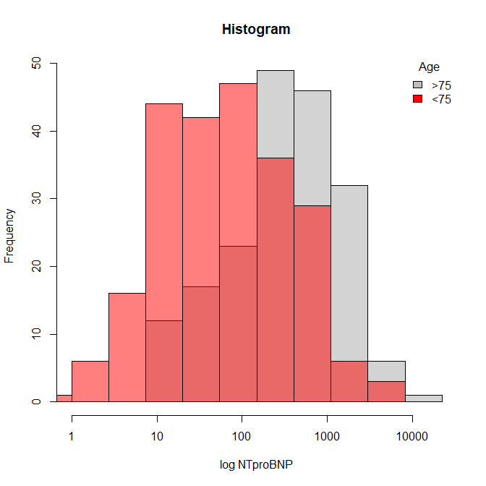
BNP as a biomarker of Heart Failure
clevelandclinic.org/ntpbnp
A normal level of NT-proBNP,
Less than 125 pg/mL age 0-74
Less than 450 pg/mL age 75-99
could we do better?

Slide 18
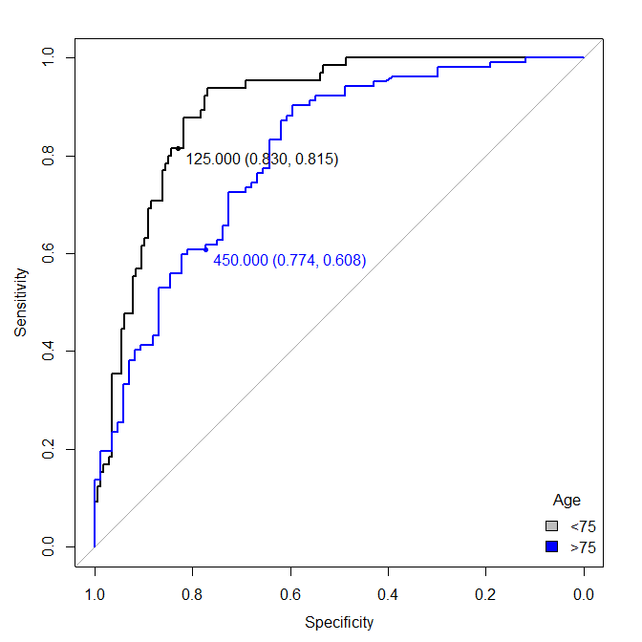
BNP as a biomarker of Heart Failure
clevelandclinic.org/ntpbnp
A normal level of NT-proBNP,
Less than 125 pg/mL age 0-74
Less than 450 pg/mL age 75-99
could we do better?

Slide 19
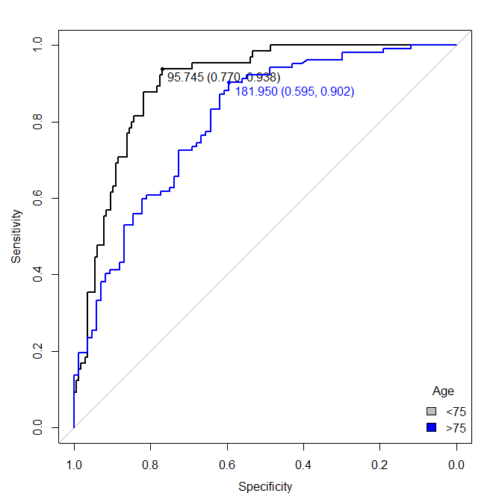
BNP as a biomarker of Heart Failure
clevelandclinic.org/ntpbnp
A normal level of NT-proBNP,
Less than 125 pg/mL age 0-74
Less than 450 pg/mL age 75-99
Youden’s criteria
Max(Senitivity+Specificity)
could we do better?

Slide 20
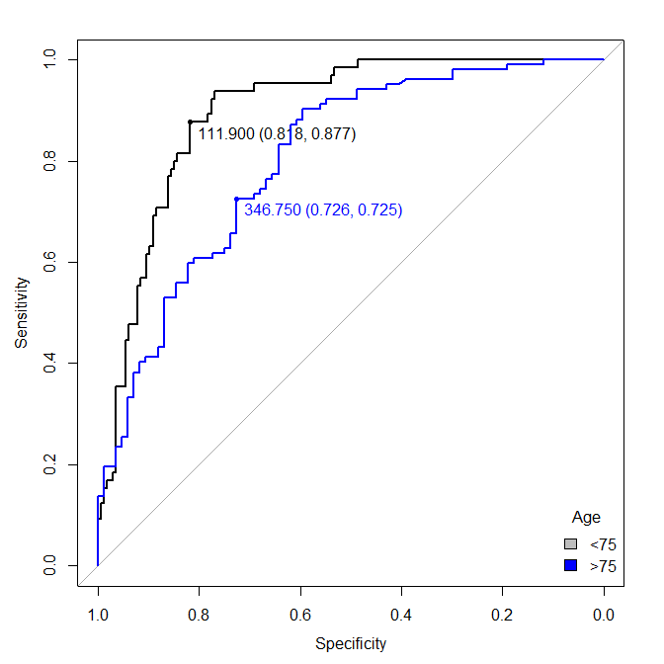
BNP as a biomarker of Heart Failure
clevelandclinic.org/ntpbnp
A normal level of NT-proBNP,
Less than 125 pg/mL age 0-74
Less than 450 pg/mL age 75-99
Topleft
could we do better?

Slide 21
What’s next
R …
Logistic regression?
Linear regression?

